Slide 1

>>> ASSIGNMENT – 1 <<<
CYBER SECURITY
WITH
IBM QRADAR
P . YEGNAESWARARAO
[ 21PC5A0502 ]
VIZAG INSTITUTE OF TECHNOLOGY

Slide 2
DAY – 1 { CYBER SECURITY }
1. CYBER SECURITY :
Cybersecurity is the practice of protecting systems, networks, and data from unauthorized access, use, disclosure, disruption, modification, or destruction. It's essentially the art of keeping your digital information safe from harm.
2. TYPES OF CYBER ATTACKS :
( 1 ) Active attacks : Directly interferes with a system to steal data, cause harm, or disrupt operations.
[ a ] Man-in-the-middle-attack [ d ] Phishing attack
[ b ] Spoofing [ e ] Replay attack
[ c ] Dos attack
( 2 ) Passive attacks : Stealthily gathers information without altering the system itself, often focusing on data theft.

Slide 3
3. ESSENTIAL TERMINOLOGY :
( 1 ) MALWARE : Malware can be used to steal sensitive information, disrupt or demage computer systems, spread to other computers, or hold data and systems hostage.
( 2 ) IP ADDRESS : IP address is a unique numerical label used to identify and locate devices on network.
( 3 ) PHISHING : Type of social engineering attack where attackers trick individuals into revealing sensitive information.
( 4 ) FIREWALL : system that monitors and controls in coming and outgoing network traffic based on predetermined security rules.
( 5 ) SOCIAL ENGINEERING : Refers to the use of psychological manipulation and deception tactics to trick individuals into revealing sensitive information.
( 6 ) RANSOMEWARE : ransomware type of malicious software that encrypts a victim's files and demands payment in exchange for the decryption key.
( 7 ) VPN [ VIRTUAL PRIVATE NETWORK ] : secure encrypted connection between a device and a remote server.

Slide 4
( 8 ) PEN TESTING : To evaluate the security of the system and identify vulnerability that could be exploited by malicious actors.
( 9 ) ANTI-VIRUS : software design to detect, prevent and remove Malicious software.
TOP 10 HACKERS……
4. PHASES OF HACKING :
[ 1 ] RECONNAISSANCE
[ 2 ] SCANNING
[ 3 ] GAINING ACCESS
[ 4 ] MAINTAINING ACCESS
[ 5 ] CLEARING TRACKS

Slide 5
DAY – 2 { INTRODUCTION TO NETWORKING }
1. CLIENT SERVER ARCHITECTURE :
Readers (clients): These are everyday users like you and me. We need information from specific books (data). We send requests to the library (server) saying which book and page we want (data request).
Librarians (servers): These are powerful computers that manage the library. They receive our requests, find the right book and page (process the data request), and send us the information we need (deliver the data).
2. OSI MODEL : The OSI model broken down into 7 easy layers:
1. Physical Layer 4. Transport Layer 7. Application Layer:
2. Data Link Layer 5. Session Layer
3. Network Layer 6. Presentation Layer
it gives you a basic understanding of how the OSI model helps make network communication possible!
3. TCP/IP [ Transmission Control Protocol ] :

Slide 6
1. Application Layer : ( SMTP, HTTP/HTTPS, FTP, SSH) 3. IP Layer : (IPv4/IPv6,ICMP,ARP)
2. TCP Layer : ( UDP, TCP ) 4. Network Layer
4. IP ADDRESSES: Imagine you want to send a letter to a specific person across town. You need their exact address to make sure your letter arrives at the right place. In the world of computers and networks, IP addresses are like those addresses, but for devices on the internet.
There are two main types of IP addresses:
Public IP address: This is your internet connection's address, like the main address of the building complex. It's usually assigned by your internet service provider (ISP).
Private IP address: This is assigned to devices within your network, like the apartment number. Only devices on your network can use these addresses.
5. PORT & PROTOCOLS :
PORT : Some common port numbers include : HTTP (web browsing): 80
HTTPS (secure web browsing): 443
FTP (file transfer): 21
SSH (secure remote access): 22
SMTP (email sending): 587
POP3 (email retrieval): 993

Slide 7
6. SUBNET : subnetwork, is a logical subdivision of a larger network. It's like dividing a big room into smaller sections to create more organized and manageable spaces.
There are two main types of IP addresses:
Public IP address: This is your internet connection's address, like the main address of the building complex. It's usually assigned by your internet service provider (ISP).
Private IP address: This is assigned to devices within your network, like the apartment number. Only devices on your network can use these addresses.
7. WINDOWS NETWORKING COMMANDS : Windows networking offers broad compatibility but requires attention to security and group policies for smooth operation.
8. CISCO PACKET TRACER : Build and experiment with virtual networks for learning and troubleshooting, no hardware needed.

Slide 8
DAY – 3 { PYTHON FOR HACKING }
1. INTRODU TION TO PYTHON :
Python, a versatile programming language is widely used in the field of cyber security and hacking due to the simplicity, flexibility & extensive libraries.
2. WHY PYTHON :
3. SETTING UP PYTHON :
4. BASIC SYNTAX : Python uses clean and simple syntax facilitating quick development and experimentation.
5. DATA TYPES : Python supports various data types including Integers, floats, strings, lists, tuples, dictonaries, & sets.
6. CONTROL STRUCTURES : Python provides control structures like if-else, statements, loops, & exception handling for managing program flow.

Slide 9
7. FUNCTIONS : It is reusable blocks of code that can be defined and called multiple times, promoting code modularity and reusability.
8. FILE HANDLING : Python offers robust file handling capabilities allowing hackers to read write and manipulate files easily
8. NETWORKING : Python standard libraries includes models like " socket " for low level networking tasks and higher level libraries like " requests " for HTTP communication.
9. WEB SCRAPING : Python libraries such as ' beautiful soup ' and ' scrapy ' facility webscrapping, extract data from websites for analysis or manipulation.
10. CRYPTOGRAPHY : Python Cryptography libraries provides tools for encryption, dicription, hashing and Secure communication crucial for securing sensitive data.
11. EXPLOIT DEVELOPMENT : Python can be used for exploit development, with libraries like ' pwn tools ' providing primitives for interacting with binary, networking protocols, and more.
12. REVERSE ENGINEERING : Python along with tools like ' IDA PRO ' and ' GHIDRA ' aids in rivers engineering task such as analysing and understanding binary executables.
13. PENETRATION TESTING : Python frameworks like METASPLOIT and scrapy assistant penetration testing by automatic task like network scanning, vulnerability assessment, & exploitation.
14. WEB APPLICATION SECURITY : Python frameworks like Django and flask help secure web

Slide 10
Application against common vulnerabilities like sql injection, XSS & CSRF.
15. MACHINE LEARNING & SECURITY : Python extensive measure learning library's like ' SCI kit 'learn and Tensorflow can be used to develop securities solution such as anomoly detection and malware classification.
PROGRAM WRITTEN FOR :
The HASLIB model implements a common interface for many secure cryptographic hash and message digest algorithms. There is one constructor method named for each type of hash. All return a hash object with the same simple interface. Constructors for hash algorithms are always present in this module.
[ BY IMPORTING HAHLIB TO CRACK AN PASSWORD ]

Slide 11
DAY – 4 { CRYPTOGRAPHY FAILURES }
CRYPTOGRAPHY FOR HASHING : Hashing crumbles data into a unique fingerprint, securing privacy but vulnerable to collisions if not chosen carefully.
TEXT BASED HASHING : Test-based hacking exploits predictable patterns in cryptographic implementations, bypassing security through carefully crafted inputs.
PACKET ANALYZER : While packet analyzers can't decrypt secure communication, they can expose metadata and vulnerabilities in protocols, aiding cryptanalysis and potential attacks.
4. CRYPTOFORCE : "Cryptoforce" could refer to two things:
( A ) Cryptocurrency exchange: Cryptoforce is a cryptocurrency exchange platform in India offering buying, selling, and trading of various digital assets.
( B ) General term: Crypto force can also represent the collective power and influence of cryptocurrency users and their impact on the financial landscape.

Slide 12
5. PORT SCANNER : While not directly involved in cryptography itself, port scanners can be used to discover and exploit vulnerabilities in network services supporting cryptographic operations, potentially bypassing encryption and compromising data security.
6.BRUTE FORCE :
Exhaustion : Brute force in cryptography tries every possible key until it unlocks the data.
7. REVER SHELL : Reverse shells in cryptography don't directly involve cryptography, but they can be used to gain unauthorized remote access by establishing a connection back to an attacker's server, bypassing traditional security measures.
8. FUZZERS : Random data throws curveballs, exposing hidden flaws in crypto's defenses.
PROGRAM WRITTEN FOR : [ YOUR NAME INTO HASH & HASH BACK TO NAME ]

Slide 13
DAY – 5 { OWASP CATEGORY & API HACKING }
HACKING WEB APPLICATIONS :
UNDERSTANDING WEB APPLICATION CONCEPTS
UNDERSTANDING WEB APPLICATION THREATS
UNDERSTANDING WEB APPLICATION HACKING METHODOLOGY
OVERVIEW WEB APPLICATION HACKING TOOLS
OVERVIEW OF WEB API’S, WEBHOOKS, & WEB SHELL CONCEPTS
UNDERSTANDING HACKING WEB APPLICATIONS VIA WEB API’S, WEBHOOKS, & WEB SHELLS
UNDERSTANDING COUNTER MEASURES FOR DIFFERENT WEB APPLICATION ATTACKS
OVERVIEW OF WEB APPLICATION SECURITY TESTING TOOLS

Slide 14
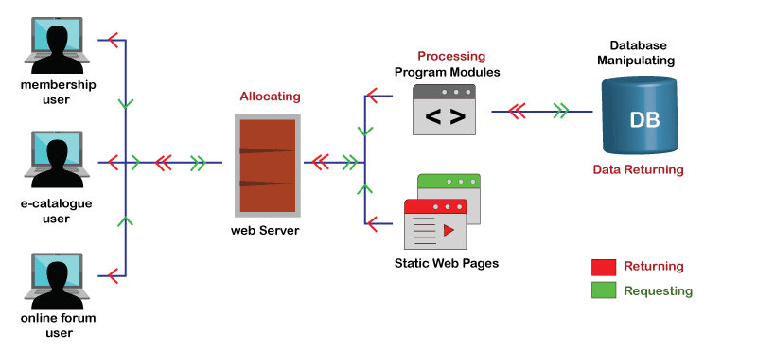
INTRODUCTION TO WEB APPLICATIONS :
A web application is a computer program that is accessed through a web browser over a network, Typically the internet. Web Applications are decide to work across different devices and platforms including desktop computer, laptops, Smartphones, and tablets.
2. HOW WEB APPLICATIONS WORKS
3. WEB APPLICATION ARCHITECTURE
4. WEB SERVICES : Web Services type of software system that enables communication between different applications OR software components over the internet. They use standardised protocols and data formats such as HTTP, XML, and JSON to allow different systems to exchange data and functionality in a platform-independent manner.
5. HOW WEB APPLICATION WORKS :

Slide 15
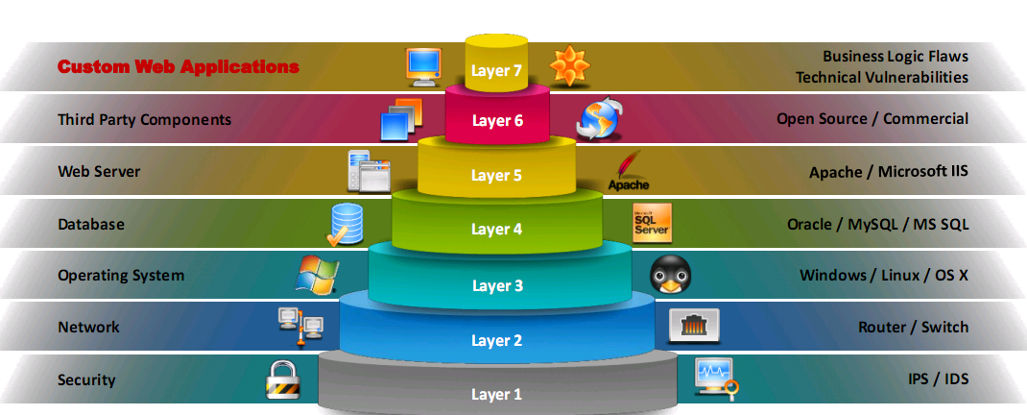
6. VULNERABILITY STACK :
7. INJECTION FLAWS :
8. BROKEN AUTHENTICATION :
9. SENSITIVE DATA EXPOSURE :
10. XXE [ EXTERNAL ENTITY ( XXE ) ] :
11. BROKEN ACCESS CONTROL :
12. A6 – SECURITY MISCONFIGURATION :
13. CROSS-SITE SCRIPTING ( XSS ) :
14. A8 – INSECURE DESERIALIZATION :
15. PRACTICAL : BROWSE ( Exploit –db.com )
16. A10 – INSUFFICIENT LOGGING AND MONITORING :
17. WEB APPLICATION HACKING METHODOLOGY :
Footprinting web arch → Analyze web app → Bypass clint-side controls → Attack Authentication mechanism → Attack authorization schemes → Attack access controls → Attack session management mechanism → Perfor injection attacks → Attack application login flaws → Attack shared environments → Attack DB connectivity → Attack web APP client

Slide 16

18. WHAT IS WEB HOOKS :
OPERATIONS OF WEBHOOKS
19. OWASP TOP 10 API SECURITY RISKS :
API1 : BROKEN OBJECT LEVEL AUTHORIZATION
API2 : BROKEN USER AUTHENTICATION
API3 : EXCESSIVE DATA EXPOSURE
API4 : LACK OF RESOURCES AND RATE LIMITING
API5 : BROKEN FUNCTION LEVEL AUTHERIZATION

